Slide 1

Toshal Infotech Pvt. Ltd., formerly known as "Idea To Working," is a privately held IT services and consulting company based in Surat, Gujarat, India. Established in 2011, the company specializes in delivering innovative software solutions tailored to meet diverse business needs.
Locations:
• Surat Office: 203, 5th Floor, SNS Interio, Althan Bhatar Road, Surat, Gujarat, 395017, India.
➢ Contact Information:
• Phone: +91 7575062161
• Email: career@toshalinfotech.com
• Website: www.toshalinfotech.com

Slide 2
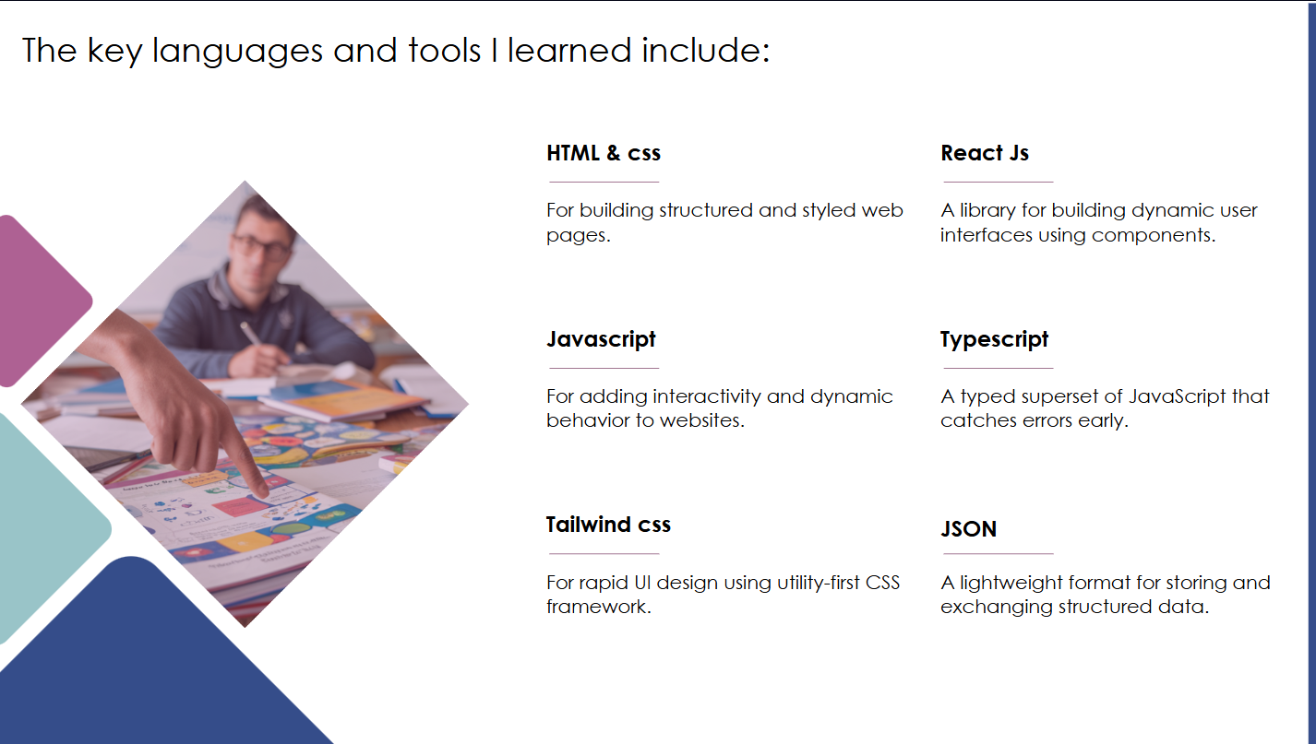
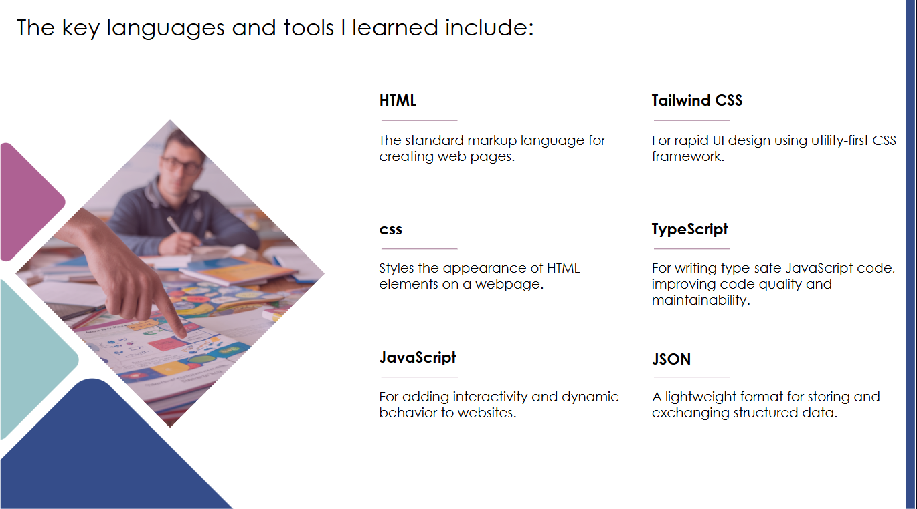

Slide 3


Slide 4
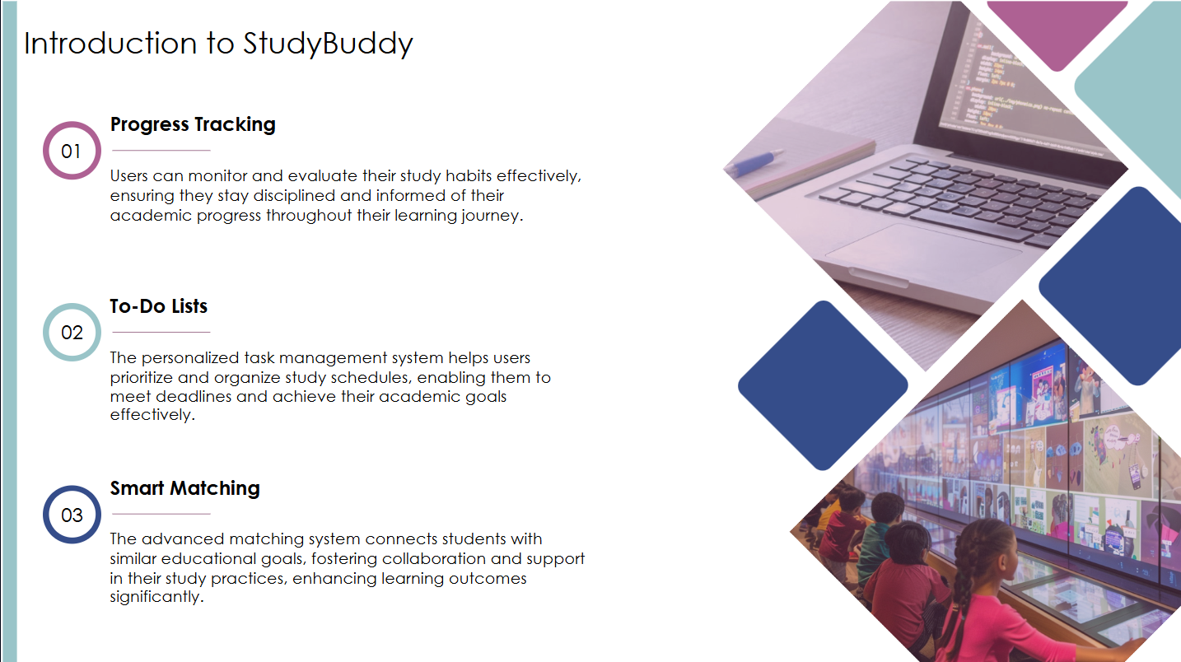
Built with modern web technologies like React.js, Node.js, MongoDB, and Socket.io, StudyBuddy focuses on enhancing the online learning experience by fostering communication, collaboration, and personalized study support.
StudyBuddy is an innovative web-based platform designed
to connect students with like-minded peers for collaborative
learning. The application serves as a smart study companion
, enabling users to find study partners, share academic resources, create and solve quizzes, engage in real-time chats, and organize their learning journey efficiently.
Built with modern web technologies like React.js, Node.js, MongoDB,
and Socket.io, StudyBuddy focuses on enhancing the online learning
experience by fostering communication, collaboration, and
personalized study support.
Whether it’s preparing for exams, solving doubts, or organizing group
studies — StudyBuddy is your go-to solution for smart, connected,
and effective learning.

Slide 5
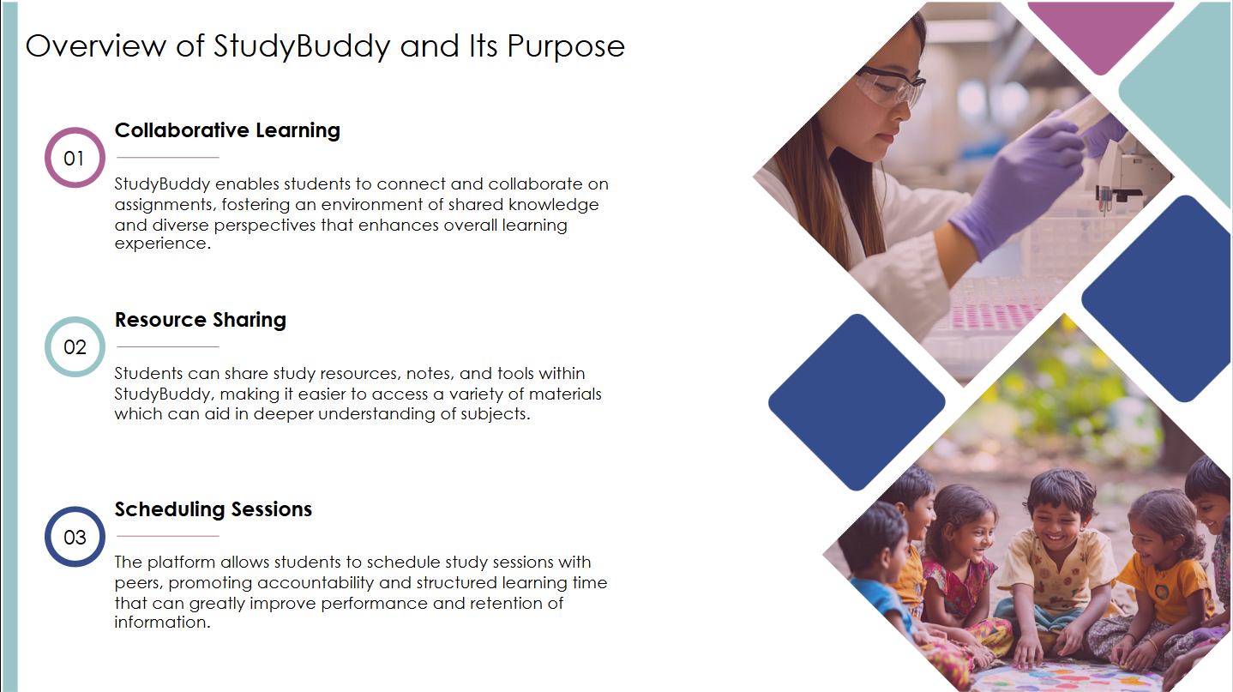

Slide 6
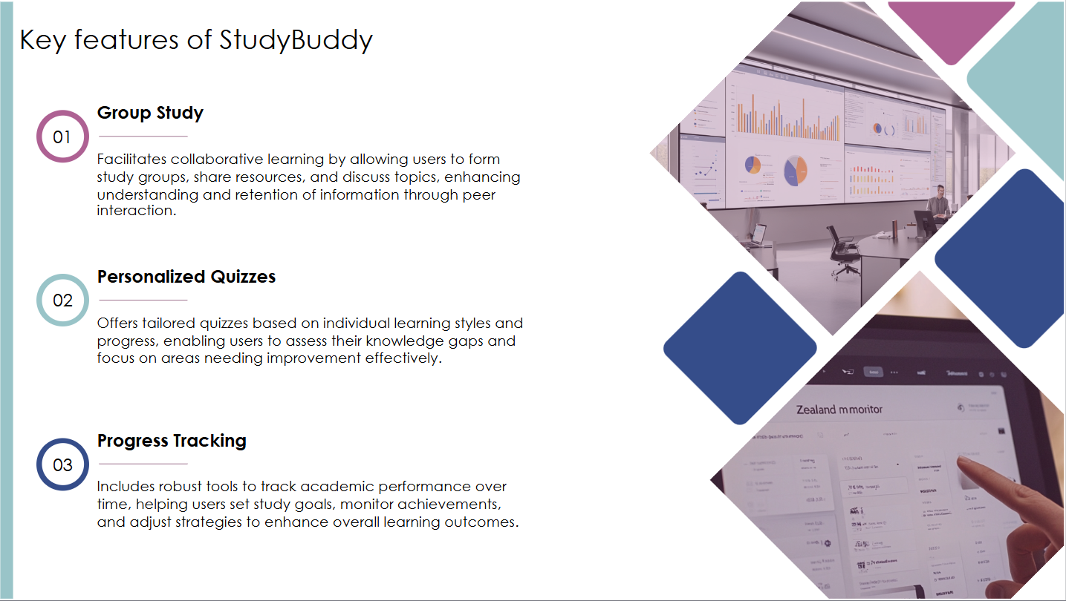
Real-time Communication
StudyBuddy provides a seamless communication system where
students can chat in real-time, share files, images, and voice notes.
It also supports audio and video calls, making it easier for users to
have face-to-face study sessions or group discussions from anywhere.
AI Quiz & Flashcard Generator
Users can upload PDFs or write notes directly on the platform, and
StudyBuddy's smart AI automatically converts this content into quizzes
and flashcards. This helps learners practice actively, retain information
better, and prepare efficiently for exams.
Study Partner Matching
Through intelligent algorithms, StudyBuddy suggests ideal study buddies
based on user interests, academic goals, and subject preferences. This
feature ensures students find the right partner to collaborate, exchange
ideas, and stay motivated.

Slide 7
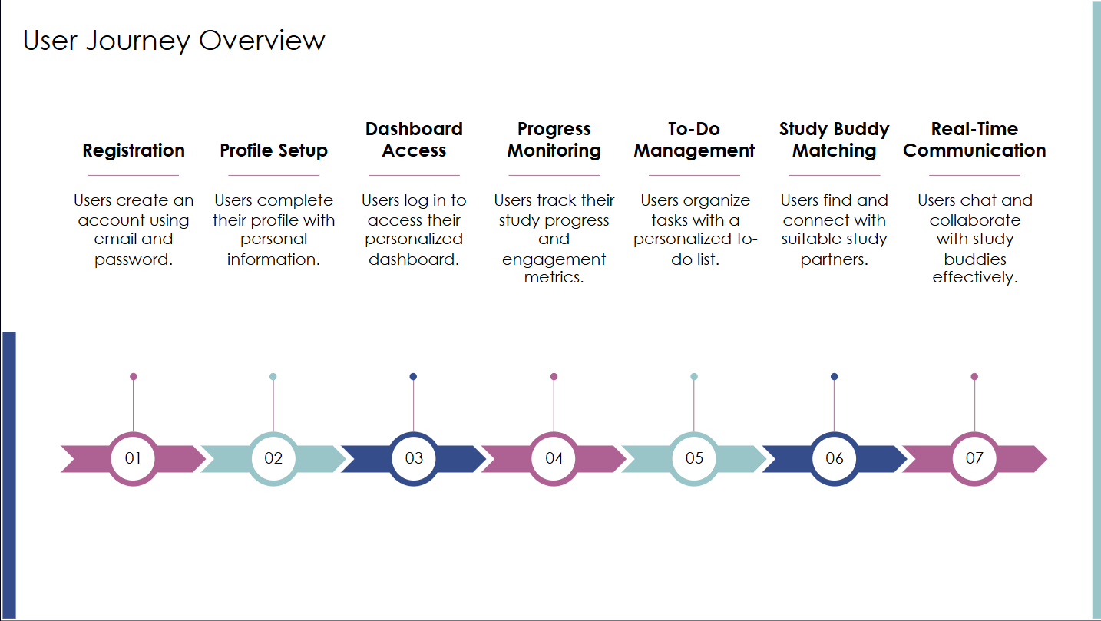

Slide 8
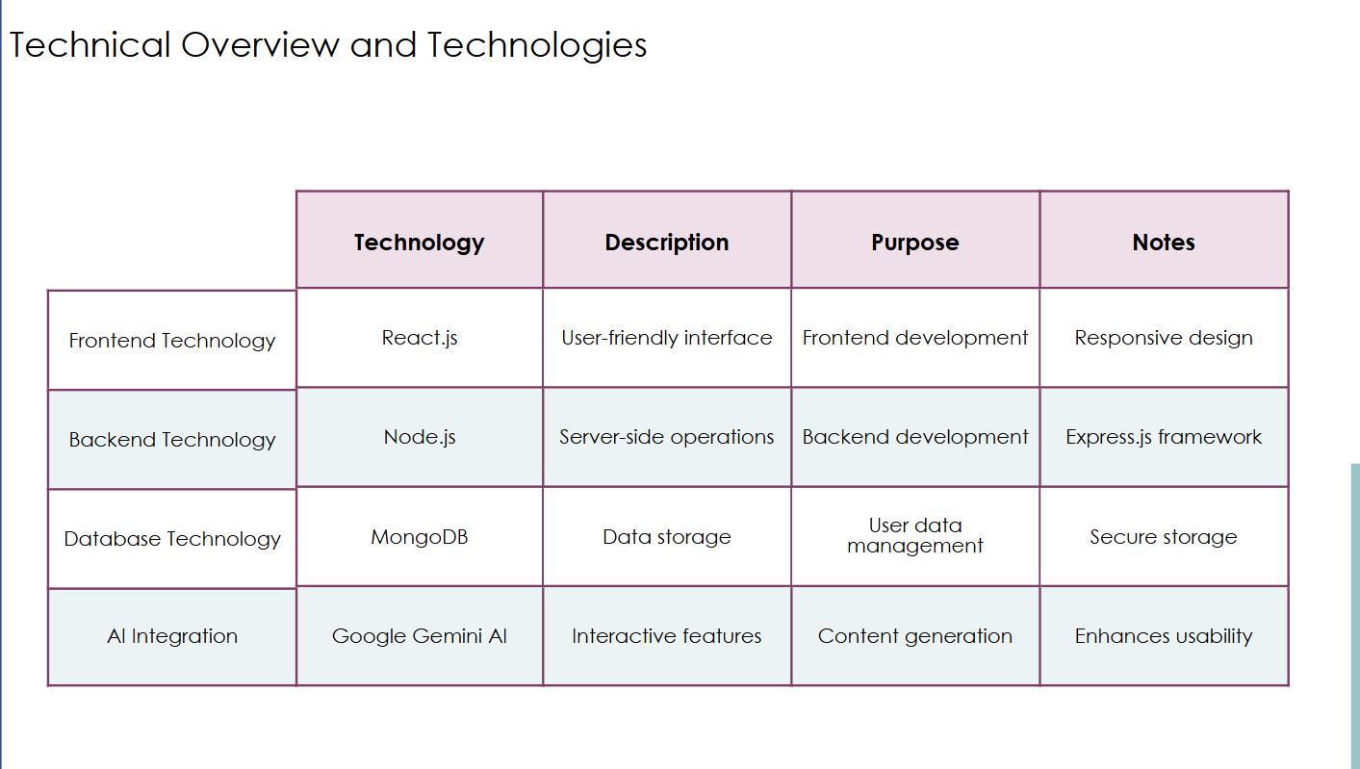

Slide 9
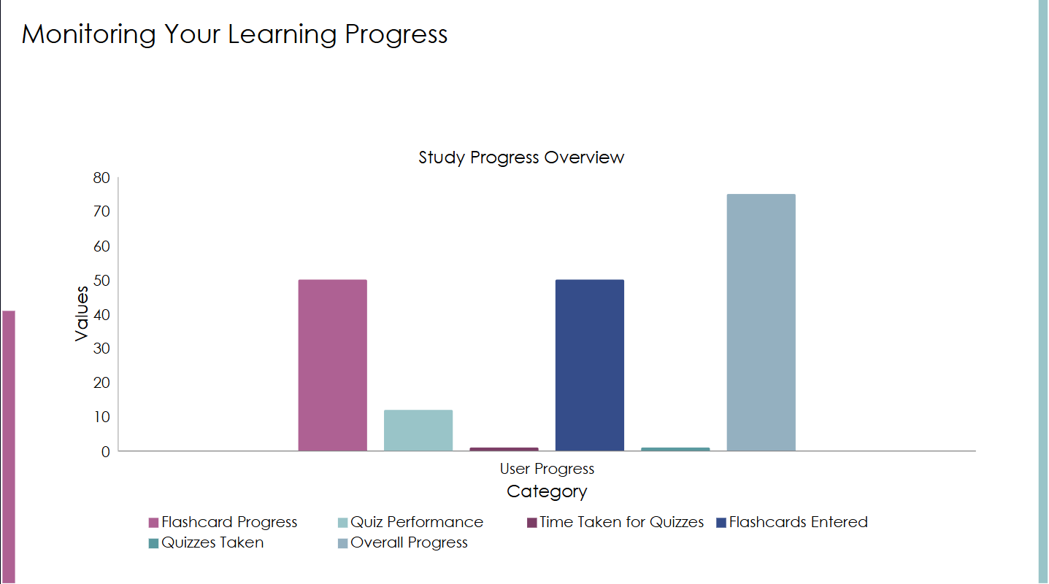

Slide 10
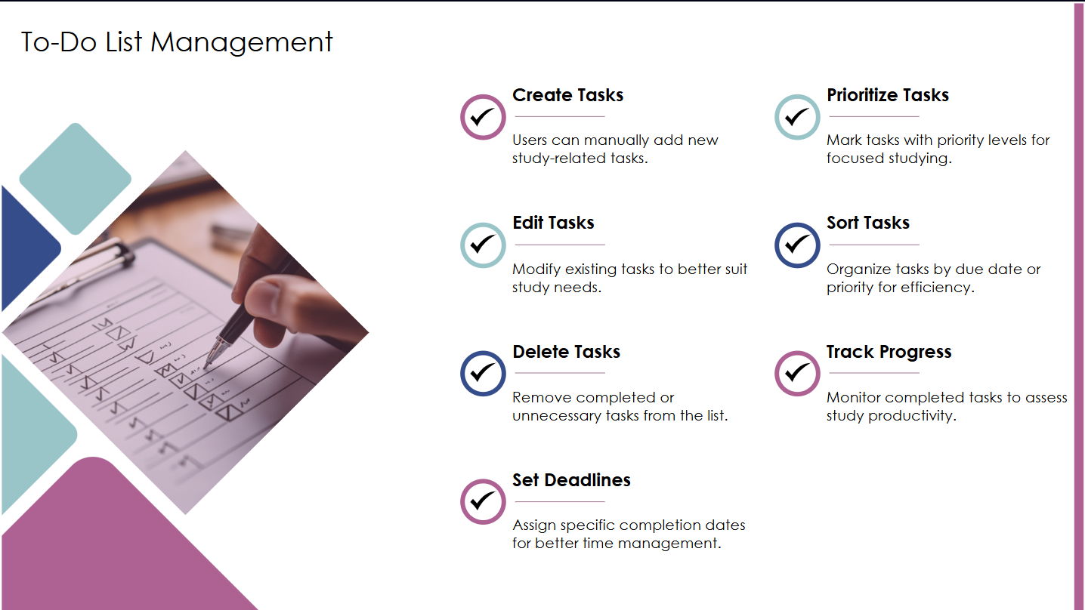

Slide 11


Slide 12
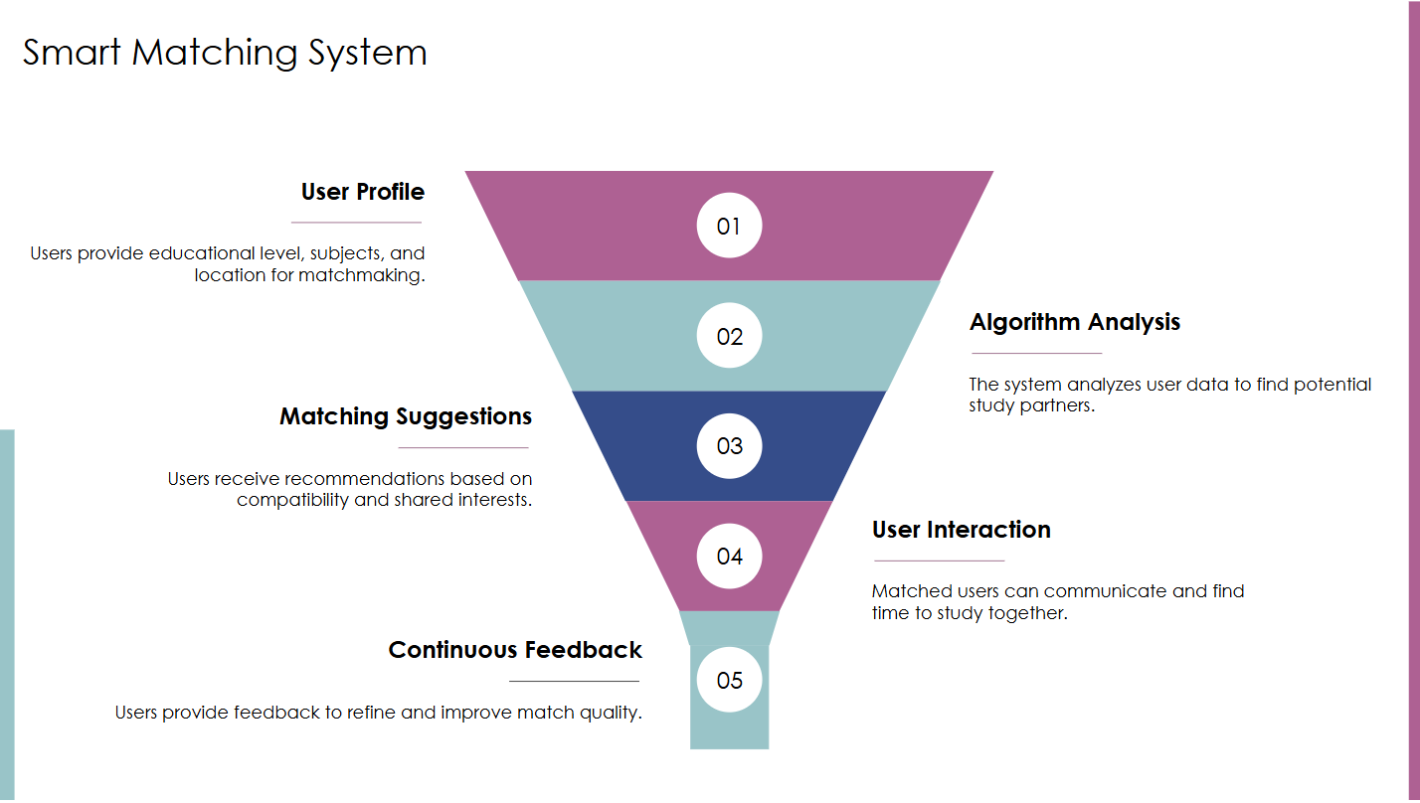

Slide 13
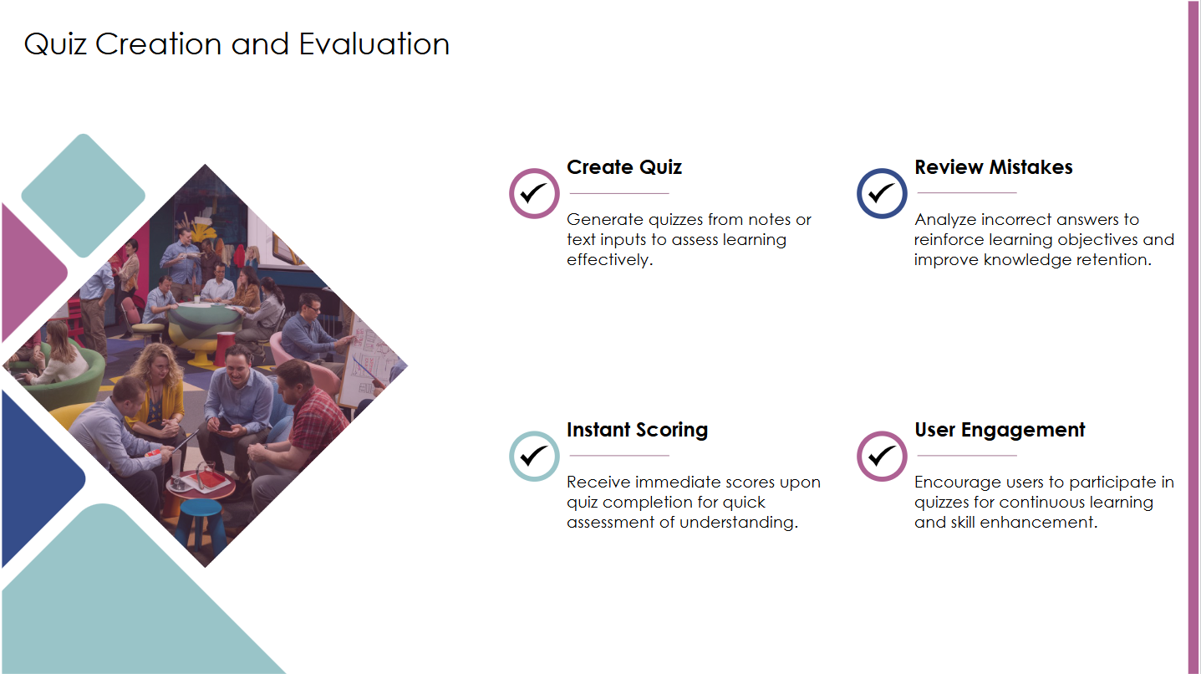

Slide 14
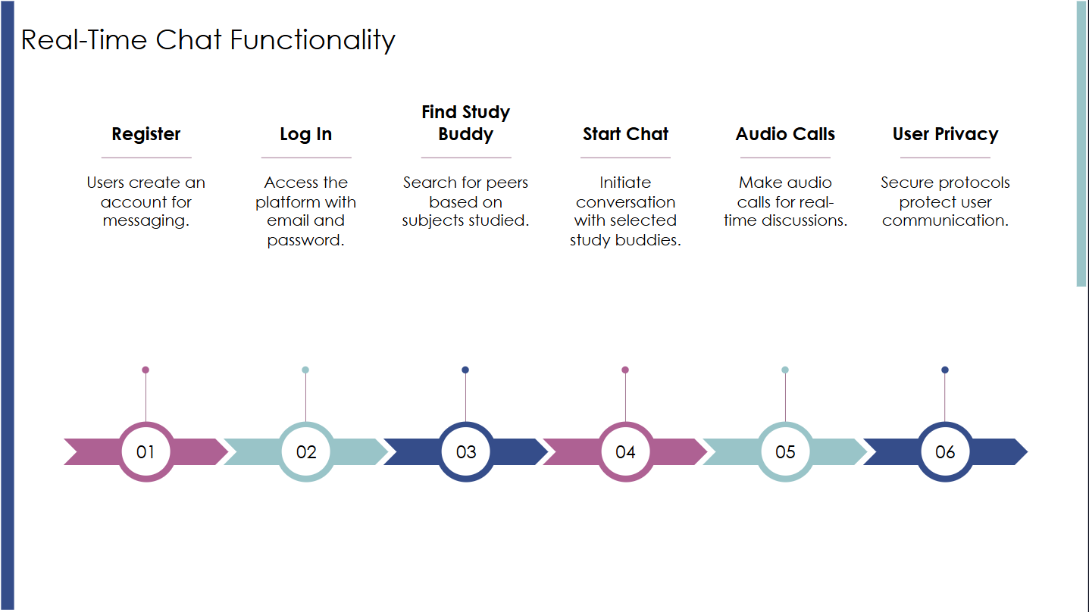

Slide 15
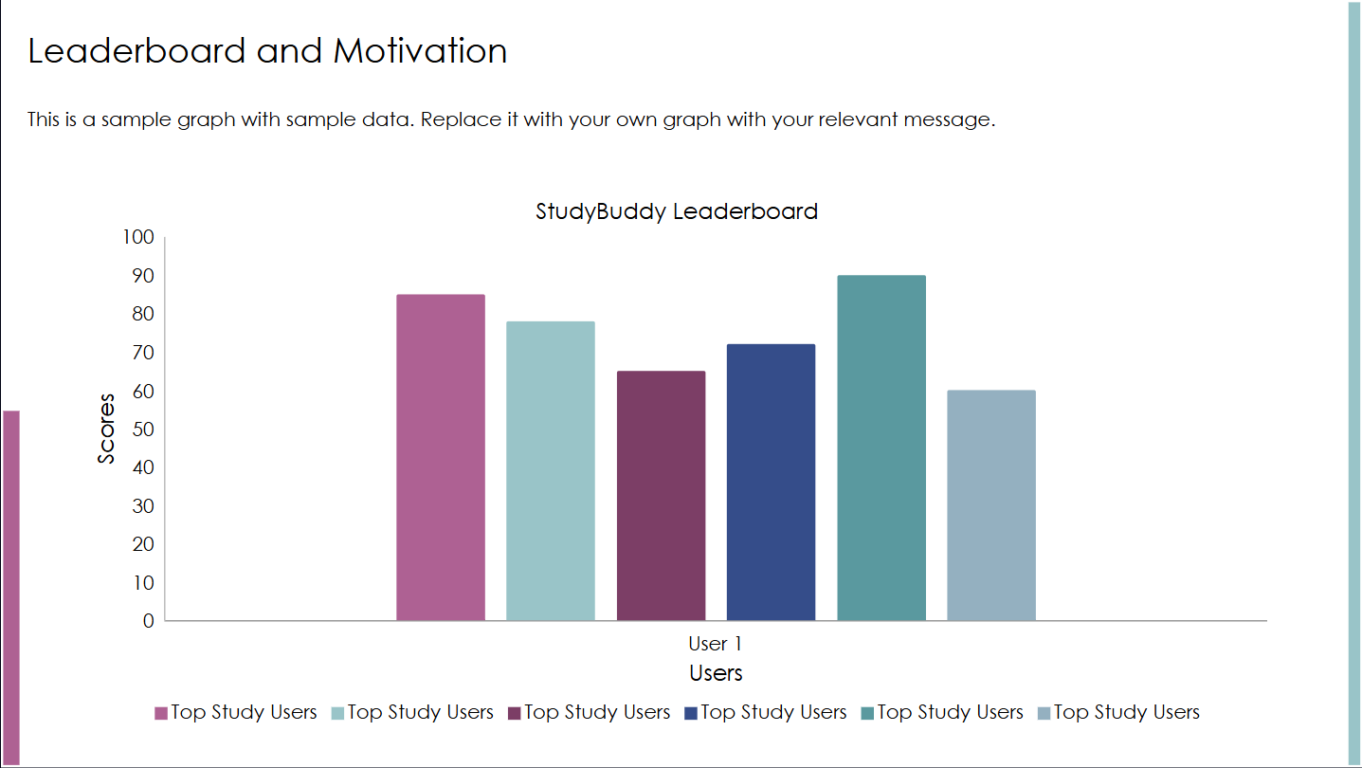
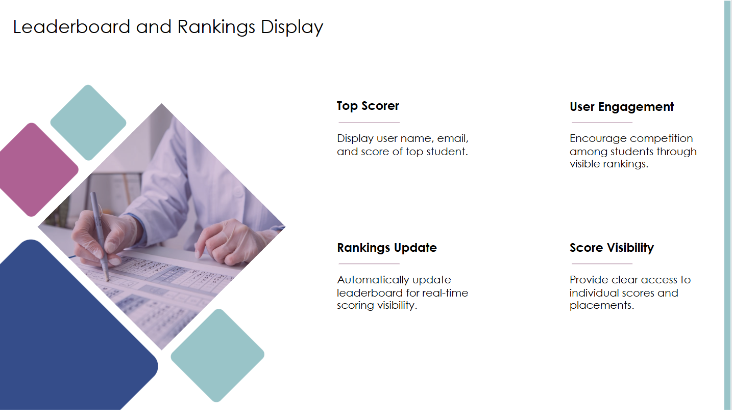

Slide 16
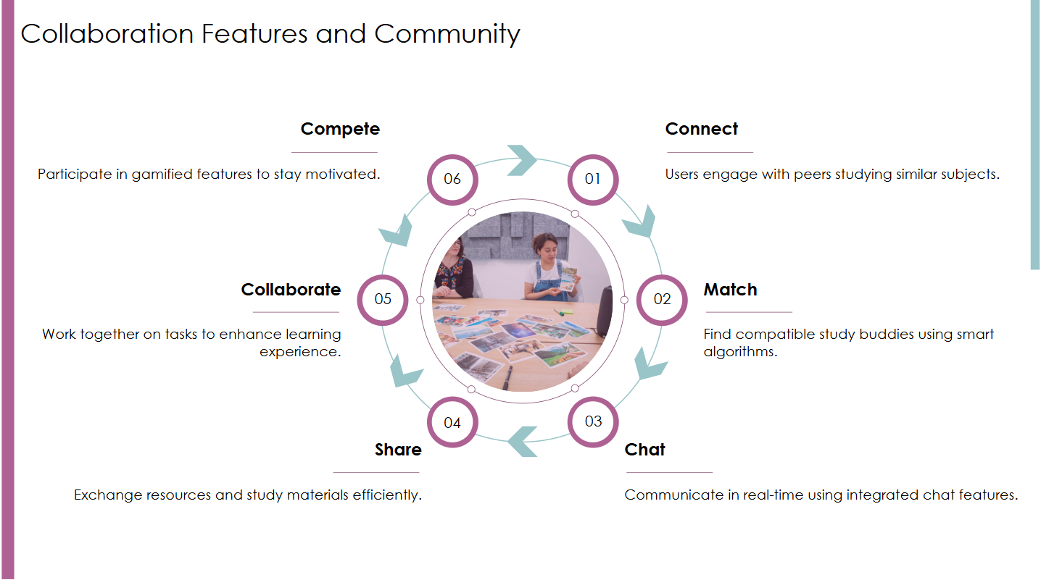

Slide 17
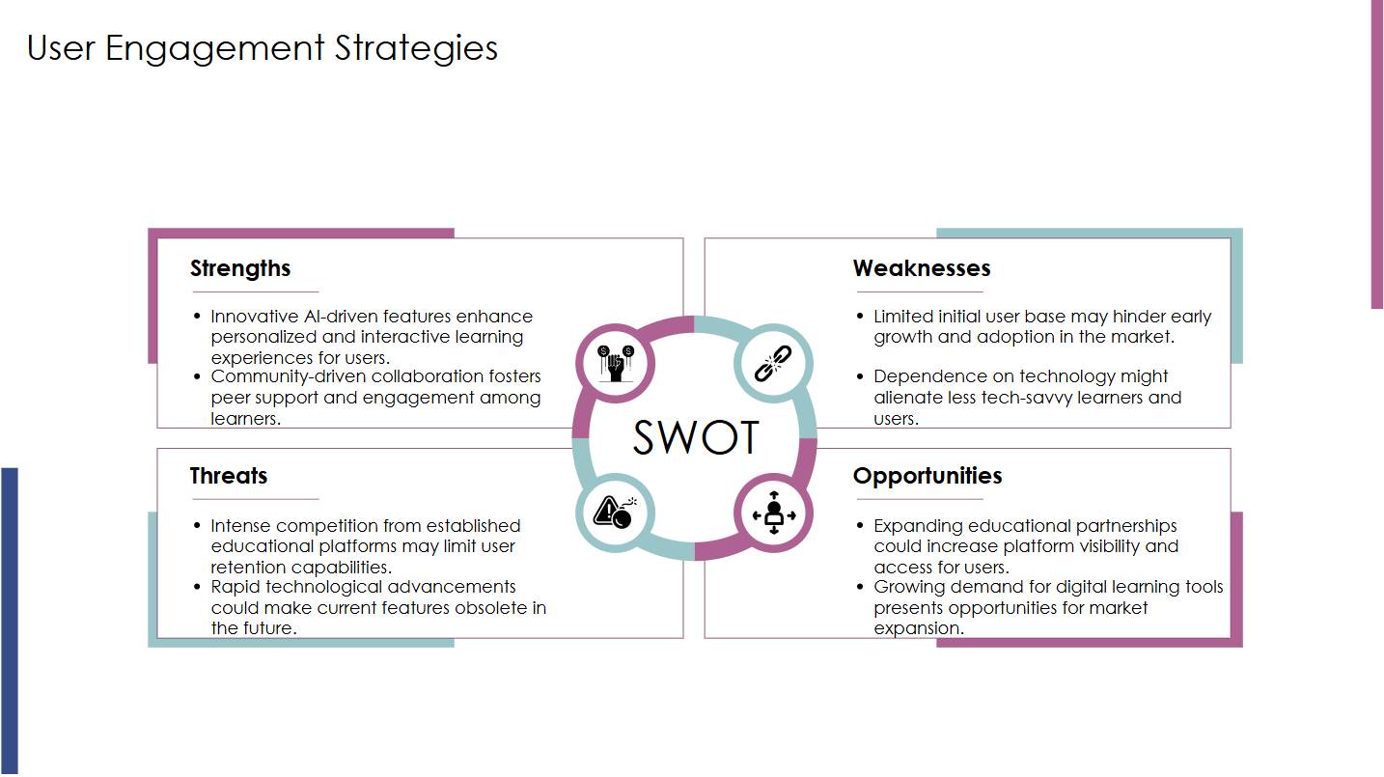

Slide 18


Slide 19


